Slide 1
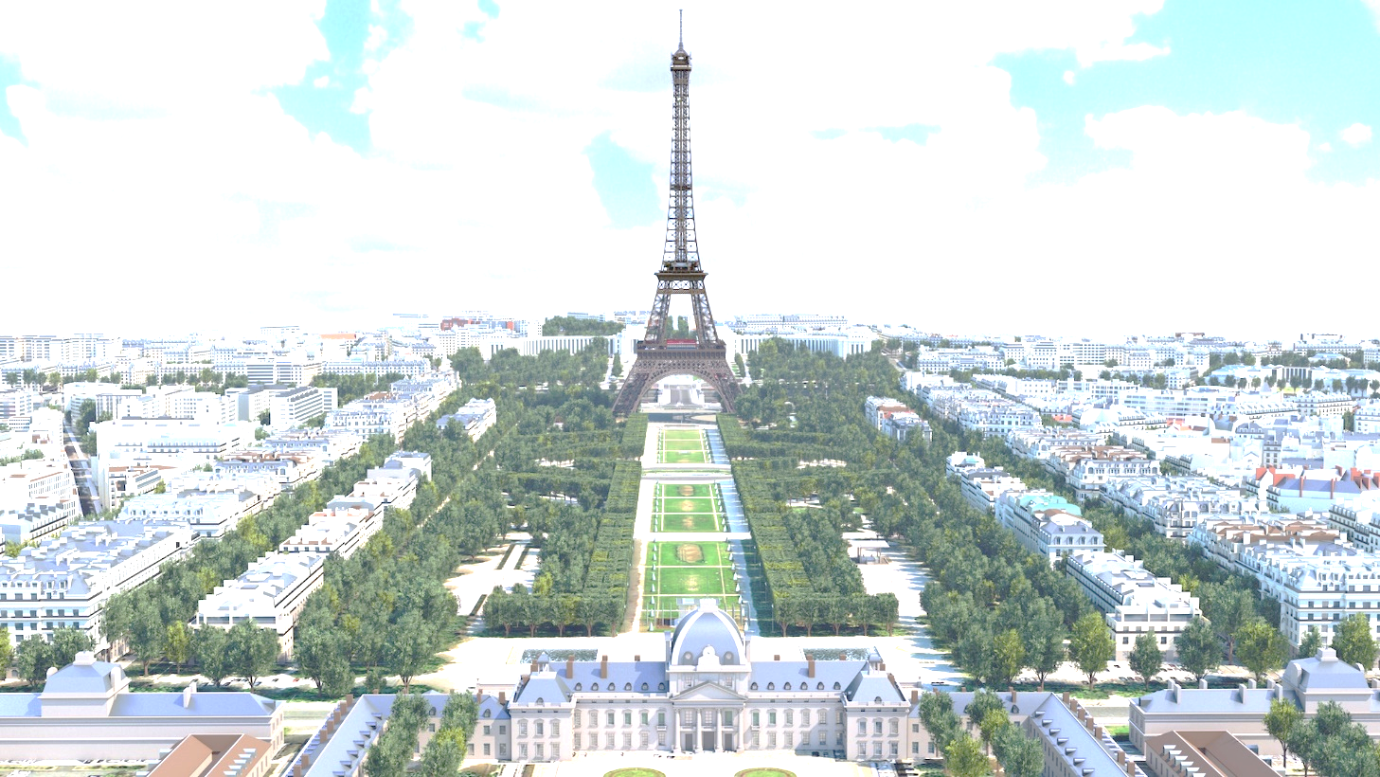
An Analysis of Restaurants in Paris, France
Based on their Types and Distance from the City Centre
By Ashish Dubey

Slide 2
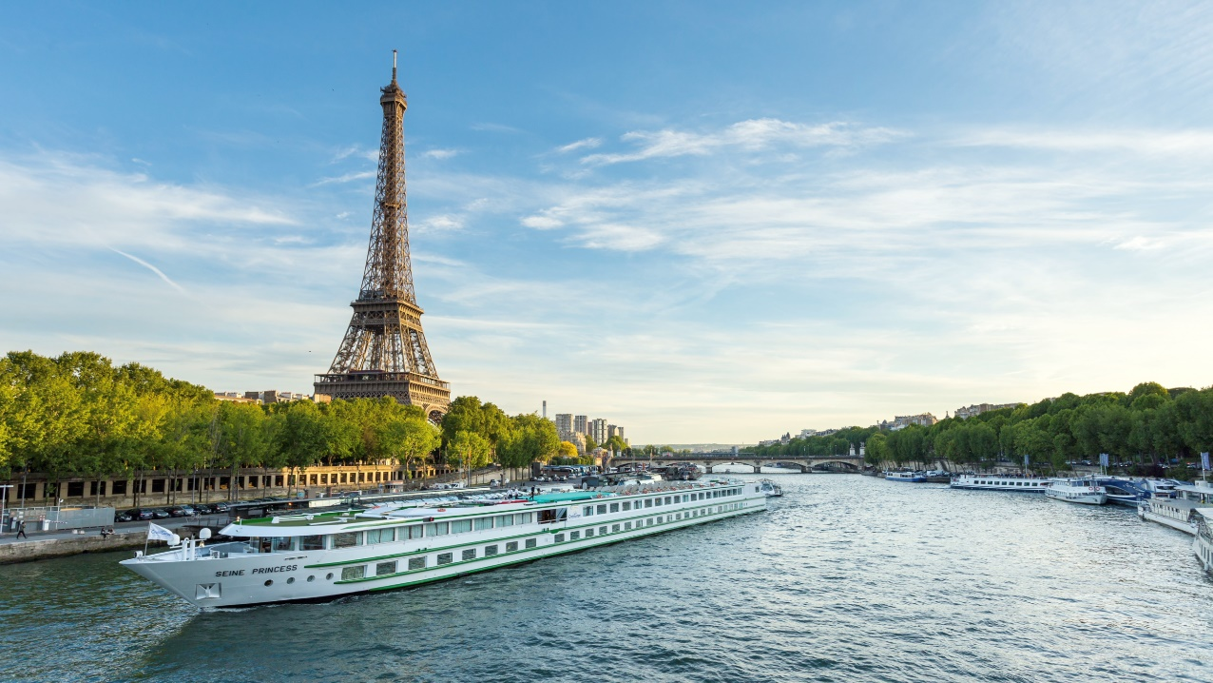
Paris - The Undisputed Culinary Capital of the World

Slide 3
Introduction

Slide 4
‘Where Do I Eat?’
Paris is certainly one of the best cities for food-culture in the entire Europe. There are abundant choices for various types of gourmet food in the city. There are also Michelin Star-chefs and Michelin star-restaurants. I have personally been to Paris on a number of occasions and have been amazed with the options available in the city. I always want to try out more. And I am sure, all tourists also would be hungry-for-more. One major problem that I have found is the distance of our places of residence in Paris to the locations of these fantastic restaurants. Therefore, I want to find out the correct distances, preferably from a central location, so as to make it easy for everyone and also so that I may be able to use it during my next visit and also share it with the community.

Slide 5
The Project

Slide 6

Startpoint
Knowledge gained in Coursera modules
Foursquare API for exact locations of all required destinations (i.e. restaurants) in Paris
Prepare and test in Jupyter Notebook of IBM Watson
Publish it on Github for analysis

Slide 7
The Process

Slide 8
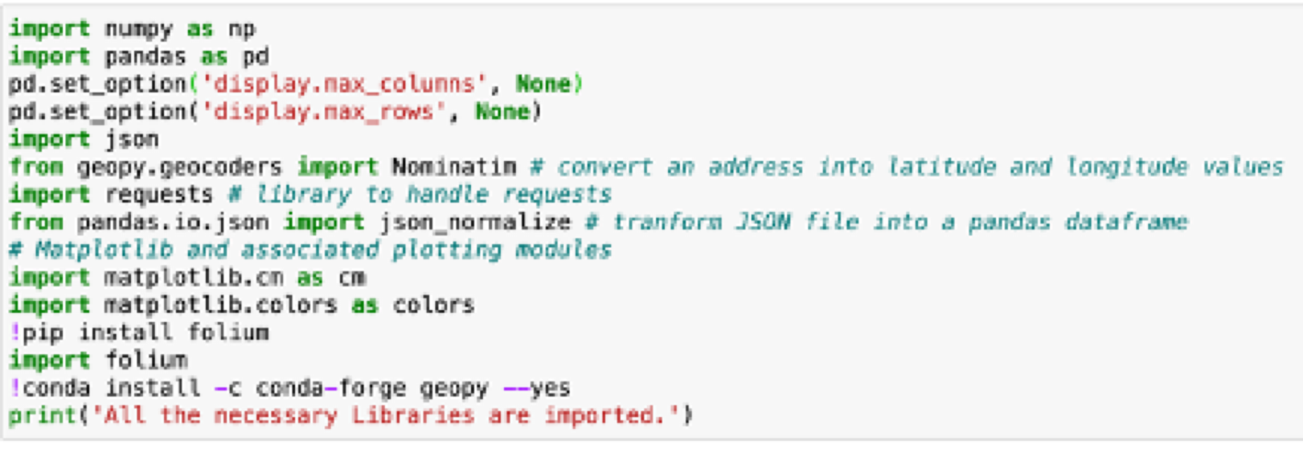
Import All Libraries
Import all required libraries

Slide 9
Locate Paris and Connect to API
Obtain the geographical location of Paris (by calling the geo-locator function).
Connect to the Foursquare API (using my credentials established in an earlier module).

Slide 10
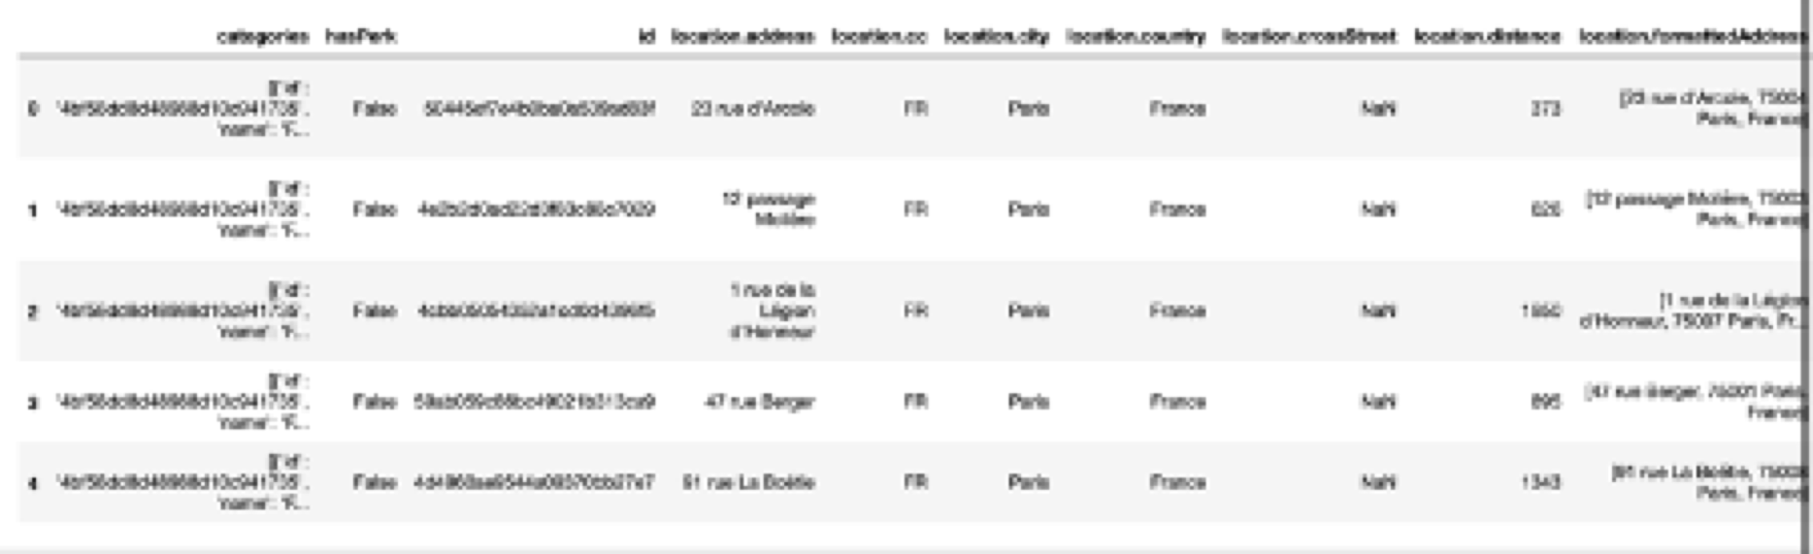
Raw Data
This is how the raw-data obtained from Foursquare API looks like

Slide 11
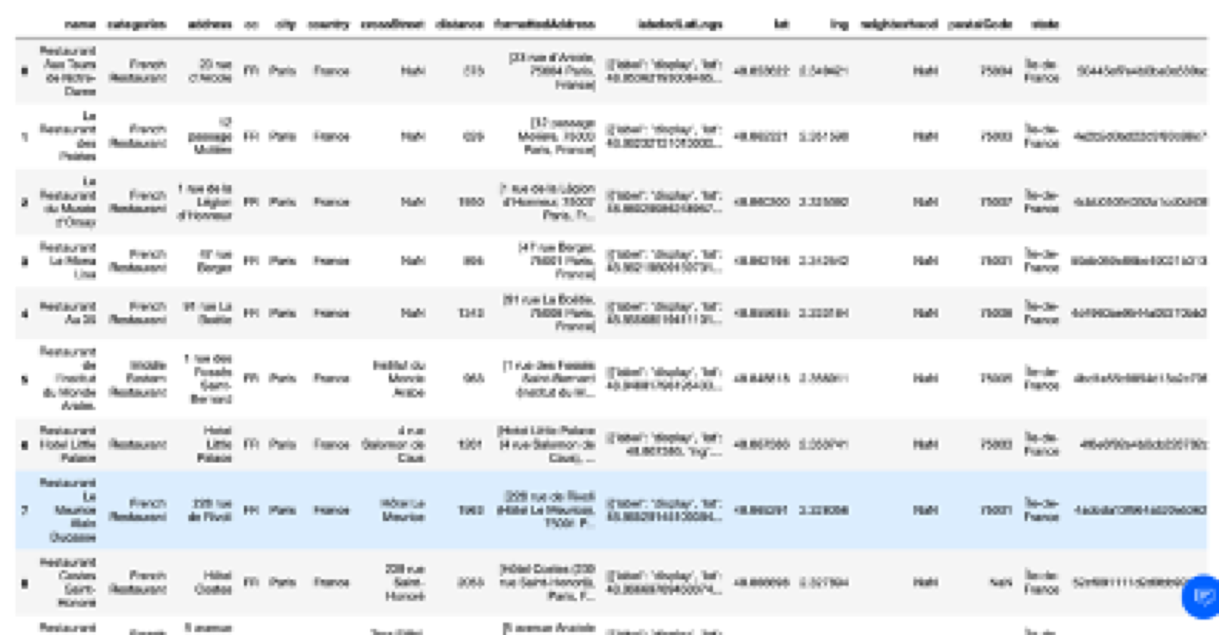
Filtered and Processed Data

Slide 12
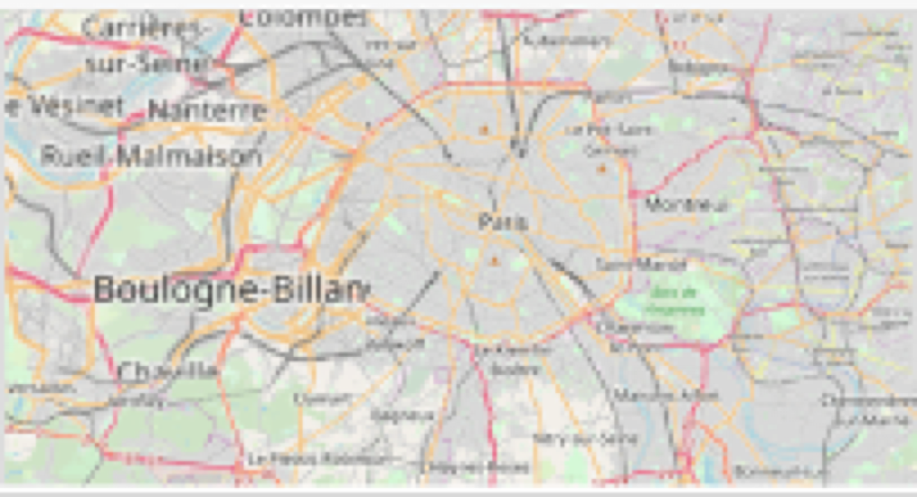
Paris
Using Folium, Paris could be seen.

Slide 13
But Where Are The Restaurants?

Slide 14
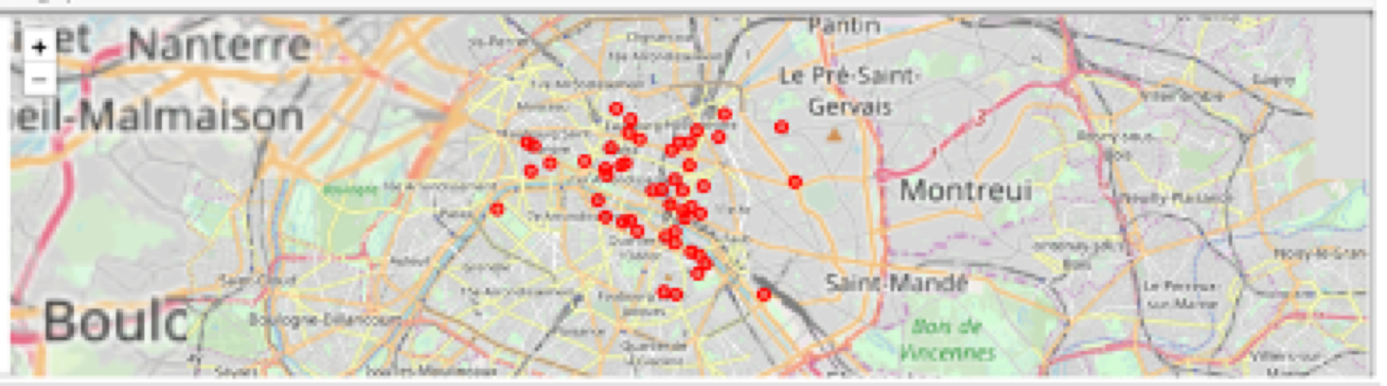
Restaurants
Now I see them with red markers

Slide 15
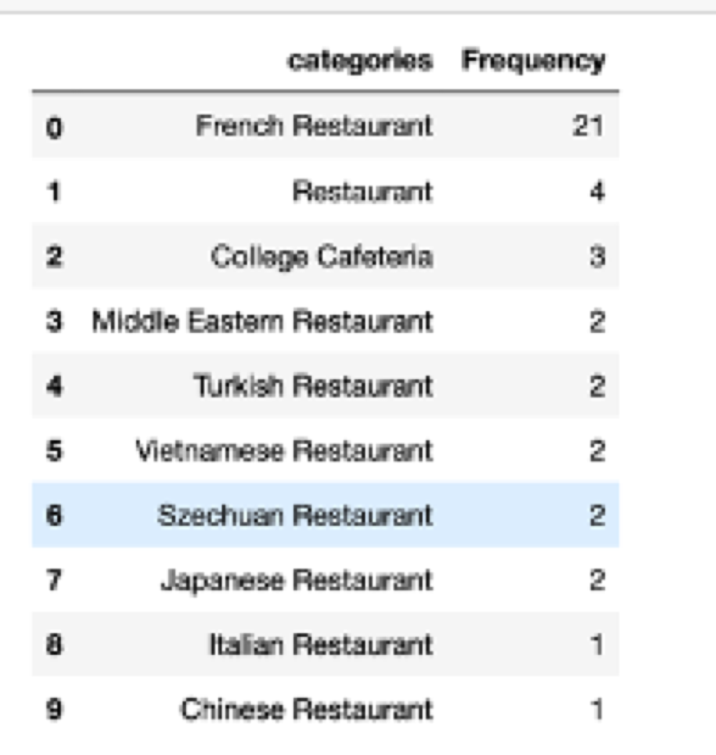
Enter Pandas
Using the data frame Paris and getting help from our Pandas

Slide 16
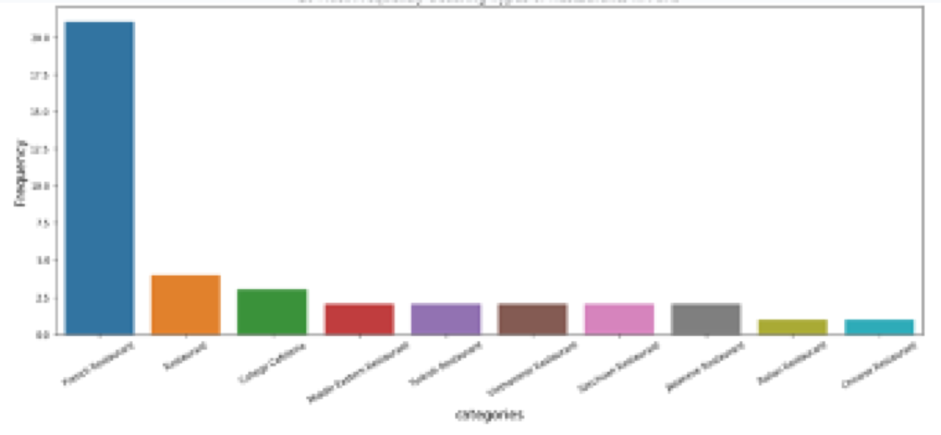
Converting to Bar Chart
Using Seaborn

Slide 17
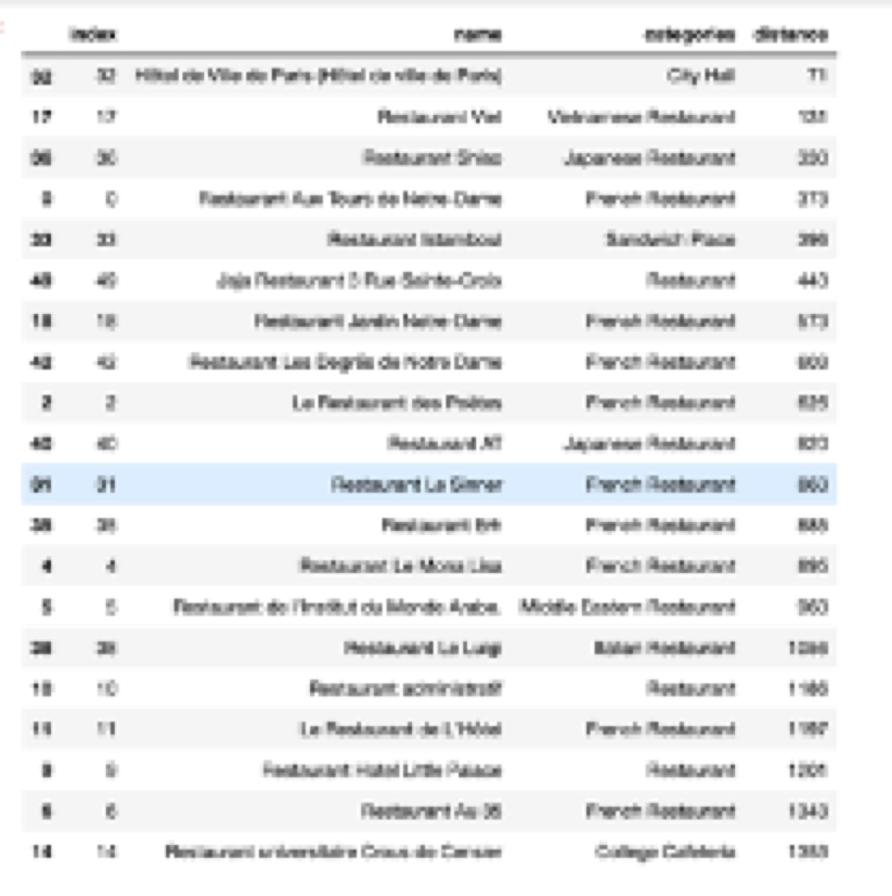
Converting to Useable Data
Reseting the Index Frame

Slide 18
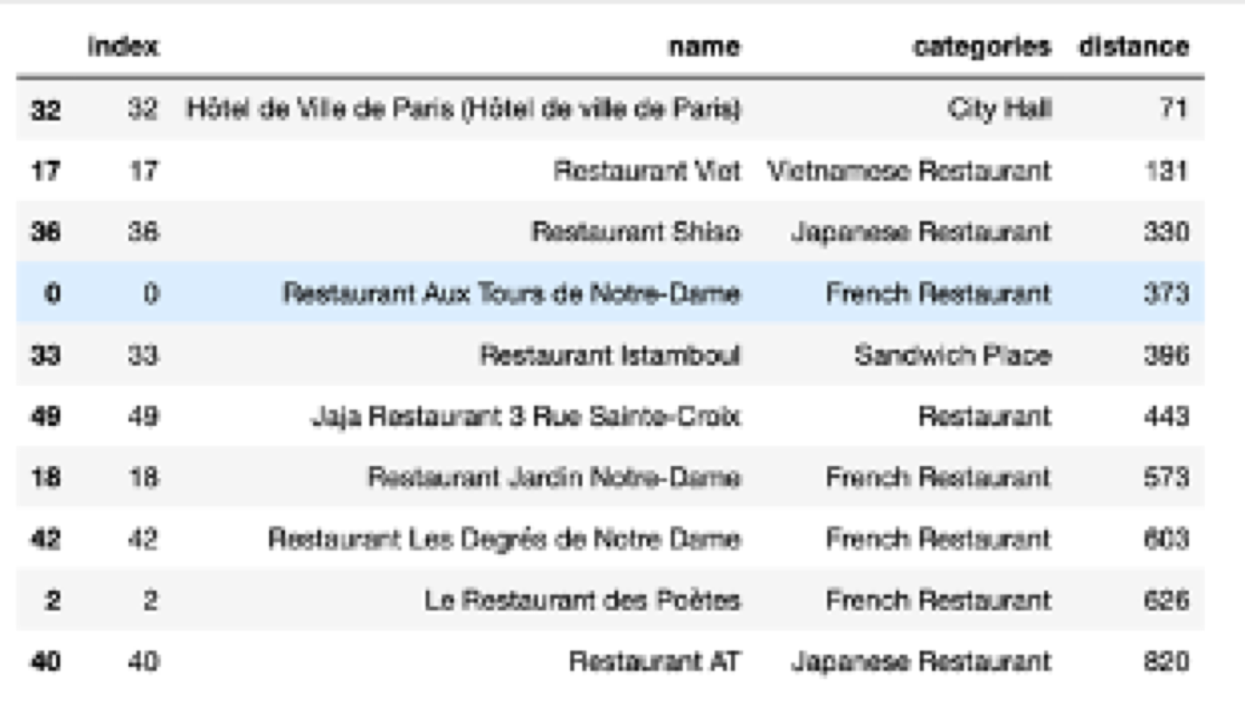
The Result

Slide 19
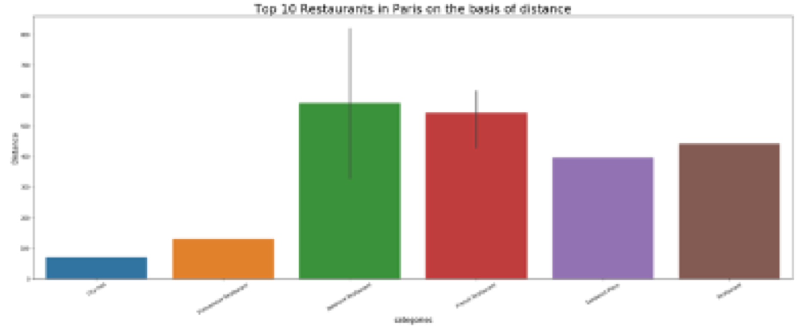
The Result

Slide 20
Conclusion

Slide 21
Whenever I visit any new country, where to stay and where to eat are always issues in front of me. I am sure, it is the same for maximum tourists. Here, I have focussed on the where to eat part of the issue. I am certain that every tourist would like to have such information at hand so as to use his time and, more importantly, his money in an optimal manner. Comparing the two bar-graphs, this looks more user friendly. It can be ascertained that Vietnamese, Japanese, French and Sandwich Place are the most suitable restaurants, based on distance from the centre, in Paris.

Slide 22
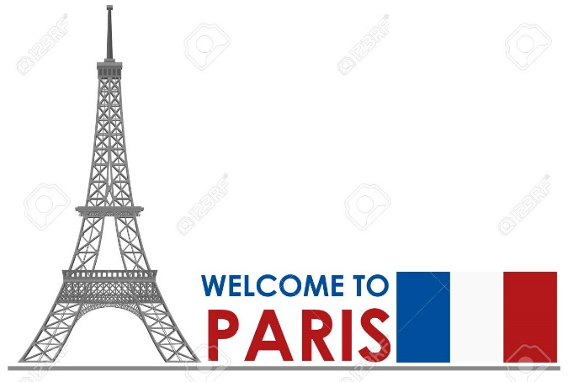
Thank you

